Slide 1
Compiled and Interpreted Languages
CMSC 330: Programming Languages

Slide 2
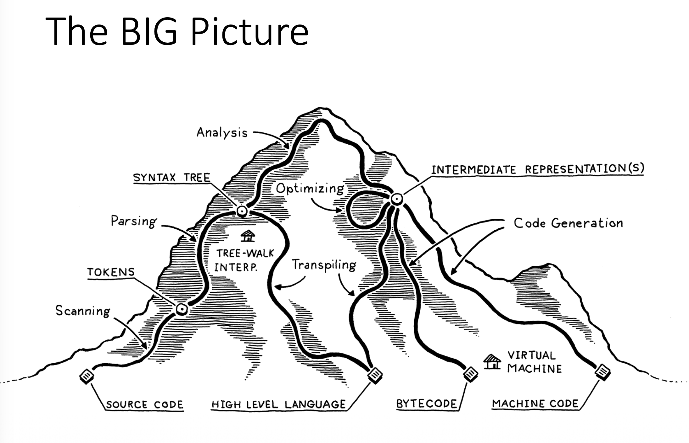
The Language Translation Pipeline

Slide 3
Scanning
A scanner takes in the linear stream of characters and chunks them together into tokens
Some tokens can be disregarded
  Whitespace often is only separator
  Comments are ignored by the language

Slide 4
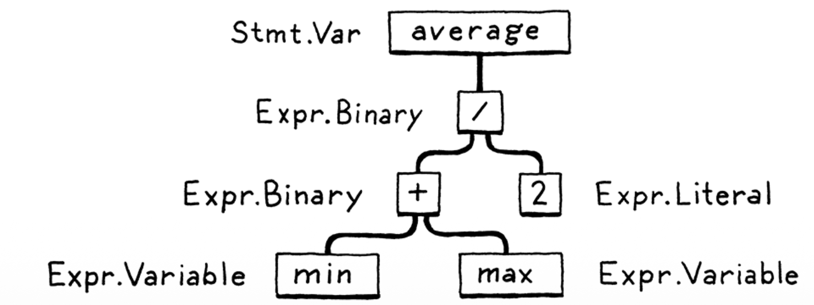
Parsing
A parser takes the sequence of tokens and builds a tree structure that mirrors the grammar
This tree can be a parse tree (directly from grammar), a syntax tree (simplified), or an abstract syntax tree (AST)

Slide 5
Semantic Analysis
Binding/Resolution
  For each identifier, language processor finds out where its name is defined and wires the two together
  This is where scope comes into play: region of source code where a use refers to a definition
Type Checking
  Once system knows where names are defined, it can also figure out their types. All operations must be valid.
  If operations are not supported, report a type error

Slide 6
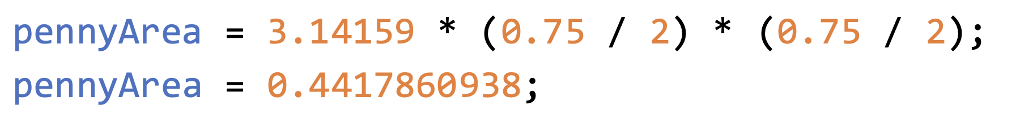
Optimizing
Once the system “understands” what the program means, it can alter some aspects
Optimizing is a safe change to the program that results in the same semantics (i.e., has the same observable behavior)
Resulting program is usually more efficient
E.g., constant folding
Can we optimize x = y*0 as x = 0?

Slide 7
Code Generation
Typically the last step
Converting IR to a form the machine can run
  Usually primitive assembly-like instructions a CPU runs and not the kind of source code a human reads

Slide 8
Code Generation: Real CPU
Target: Actual hardware instruction sets
Examples: Intel x86-64, ARM AArch64, PowerPC, MIPS
Pipeline:
Source → AST → (IR) → Machine Code
Runs directly on hardware → fastest execution
Architecture-specific (must recompile for each CPU)
Typical for C, C++, Rust, Go

Slide 9
Code Generation: Virtual CPU
Target: Instructions for a virtual machine
Examples: LLVM IR, Java bytecode, .NET CIL, Python bytecode
Pipeline:
Source → AST → Virtual-CPU Code → VM (interpret or JIT)
Portable across architectures
VM can interpret or JIT
Performance penalty (interpretation/JIT overhead)

Slide 10
Running Your Program
Two Major Components
Virtual Machine (VM)
  Only needed for languages that target Virtual CPUs
  Converts virtual CPU instructions to real CPU instructions at runtime
Language Runtime
  Needed by all languages
  “Extra space” required to have a language operate

Slide 11
Language Runtime
Extra components that provide services while a program is running. These are required for the language’s features to work correctly
Examples:
  Memory Management: Garbage collector allocates/frees memory for objects and strings
  I/O Library: Functions like print() or System.out.println() write to the console
In compiled languages, runtime code is included in the executable
In interpreted or bytecode languages, the runtime is a separate VM or interpreter

Slide 12
Compilers and Interpreters
BOTH must scan and parse
Compiler typically does extensive analysis and optimization
Compiler does Code Generation, but interpreter does NOT
What languages are usually compiled?
What are usually interpreted? Which can be both?

Slide 13
Compiled Languages
Compiling is an implementation technique that involves translating a source language to some other form
  When you generate bytecode or machine code, you are compiling
  When you transpile to another high-level language, you are compiling too
When we say a language implementation is a compiler, we mean it translates source code to some other form but does NOT execute it

Slide 14
Interpreted Languages
When we say a language implementation is an interpreter, we mean it takes in source code and executes it immediately
The interpreter itself is a program, so it must be compiled (or otherwise implemented) to run on the machine
The interpreter then takes the source program (or bytecode) as input and executes it line by line or instruction by instruction, immediately, without producing a separate executable

Slide 15
Language != Implementation
Language Implementations can either be
  Compiled (AOT)
  Interpreted/Hybrid (some of which use JIT for runtime optimization)
Statements:
  I can write an interpreter for C++
  I can write a compiler for JavaScript

Slide 16
Language | Compiled to Machine code | JIT | Interpreted/Hybrid
Java | No (compiles to bytecode) | Yes | Hybrid: from bytecode, interpreter handles initial execution JIT compiles hot spot
C/C++ | Yes | No | No
OCaml | Yes | Optional | Hybrid if using bytecode interpreter
JavaScript | No (compiles to IR) | Yes | Hybrid (interpreter + JIT, like Java)
Python | No (compiles to IR) | Optional | Cpython: interpret IR PyPy: (interpreter + JIT, like Java)
C# | No (compiles to CIL bytecode) | Yes | Hybrid (interpreter + JIT, like Java)
Rust | Yes | No | No
Fortran | Yes | No | No

